Slide 1


Responsible CS (1/2)
OpenAi’s powerful text generating model : GPT-2
GPT-2 supposedly generates human-like text
Full model considered “too dangerous,” not released yet
Smaller models released to select groups
Harvard researchers working on fake text detection technology specifically trained on GPT-2
Sources:
https://www.bbc.com/news/technology-49446729
https://news.harvard.edu/gazette/story/2019/07/researchers-develop-a-method-to-identify-computer-generated-text/?utm_source=SilverpopMailing&utm_medium=email&utm_campaign=Daily%20Gazette%2020190731%20(1)

Slide 2
Responsible CS (2/2)
Consequences
researchers can use the model to better classify which articles are real vs. fake
other parties can use the technologies to generate fake news that can confuse the public, and influence their decisions
Was OpenAI’s decision to release its model ethical?

Slide 3
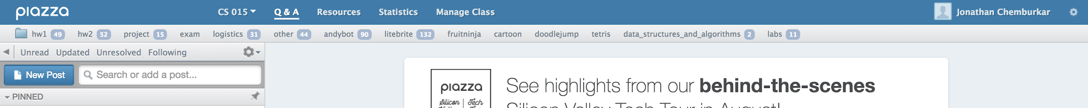
TopHat Question: Piazza
Are you reading Piazza posts and posting questions to Piazza?
Reading
Posting
Reading and Posting
Not using

Slide 4
TopHat Question: TA Hours
Are you attending TA Hours?
Usually (once to multiple times a week)
Sometimes (twice a month)
Not Yet

Slide 5


Top Hat Question: Lectures
In general, how is the pace of in-class lectures?
Moves too slowly
About right
Moves too quickly

Slide 6
TopHat Question: Lecture Capture
Are you reviewing the lecture captures on the website?
Usually (once to multiple times a week)
Sometimes (twice a month)
Not Yet
Notes:
1:00

Slide 7

Lecture 6
Inheritance and Polymorphism

Slide 8

Outline
Inheritance
Overriding Methods
Indirect Inheritance
Abstract Classes

Slide 9
Similarities? Differences?
What are the similarities between a convertible and a sedan?
What are the differences?

Slide 10
Convertibles vs. Sedans
Convertible
Sedan
Might have only 2 seats
Top down/up
Drive
Brake
Play radio
Lock/unlock doors
Turn off/on engine
5 seats

Slide 11
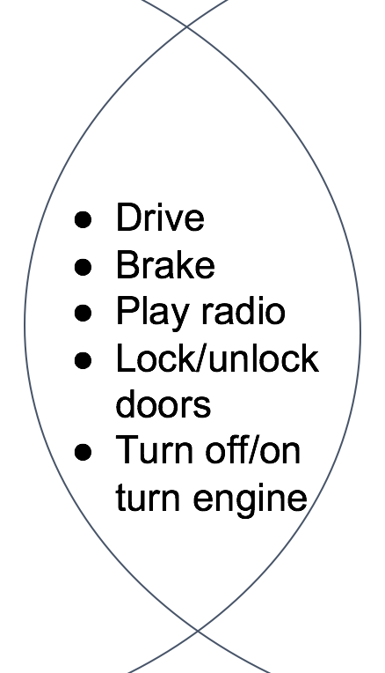
Digging deeper into the similarities
A convertible and a sedan are extremely similar
Not only do they share a lot of the same capabilities, they perform these actions in the same way
both cars drive and brake the same way
let’s assume they have the same engine, chassis, door, brake pedals, fuel systems, etc.

Slide 12
Can we model this in code?
In many cases, objects can be very closely related to each other
convertibles and sedans drive the same way
flip phones and smartphones call the same way
Brown students and Harvard students study the same way
Imagine we have an Convertible and a Sedan class
can we put their similarities in one place?
how do we portray that relationship with code?
Convertible
putTopDown()
putTopUp()
turnOnEngine()
turnOffEngine()
drive()
Sedan
parkInCompactSpace()
turnOnEngine()
turnOffEngine()
drive()

Slide 13
Interfaces
We could build an interface to model their similarities
build a Car interface with the following methods:
turnOnEngine()
turnOffEngine()
drive()
etc.
Remember: interfaces only “declare” methods
each class that extends Car will need to “implement” Car’s methods
a lot of these method implementations would be the same across classes
Convertible and Sedan would have the same definition for drive(), startEngine(), shiftToDrive(), etc.
Is there a better way where we can reuse the code?

Slide 14
Inheritance
In OOP, inheritance is a way of modeling very similar classes
Inheritance models an “is-a” relationship
a sedan “is a” car
a poodle “is a” dog
a dog “is a” mammal
Remember: Interfaces model an “acts-as” relationship
You’ve probably seen inheritance before!
taxonomy from biology class
in biology, any level has all of the guaranteed capabilities of the levels above it but is more specialized
a dog inherits the capabilities of its “parent,” so it knows what a mammal knows how to do (and more)
we will cover exactly what is inherited in Java class hierarchy shortly…
Animalia
Chordata
Mammalia
…
Canis

Slide 15
Let’s examine inheritance further
Model inheritance relationship
Adding new methods
Overriding methods
Accessing Instance Variables

Slide 16
Modeling Inheritance (1/3)
This is an inheritance diagram
each box represents a class
A Poodle “is-a” Dog, a Dog “is-a” Mammal
transitively, a Poodle is a Mammal
“Inherits from” = “is-a”
Poodle inherits from Dog
Dog inherits from Mammal
for simplicity, we’re simplifying the taxonomy here a bit
This relationship is not bidirectional
a Poodle is a Dog, but not every Dog is a Poodle (could be a Labrador, a German Shepherd, etc.)
Mammal
Dog
Poodle
Labrador

Slide 17
Modeling Inheritance (2/3)
Superclass/parent/base: A class that is inherited from
Subclass/child/derived: A class that inherits from another
“A Poodle is a Dog”
Poodle is the subclass
Dog is the superclass
Mammal
Dog
Dog
Poodle
Poodle
Labrador

Slide 18

Modeling Inheritance (3/3)
Superclass/parent/base: A class that is inherited from
Subclass/child/derived: A class that inherits from another
“A Poodle is a Dog”
Poodle is the subclass
Dog is the superclass
A class can be both a superclass and a subclass
e.g., Dog
You can only inherit from one superclass
no Labradoodle as it would inherit from Poodle and Labrador
other languages, like C++, allow for multiple inheritance, but too easy to mess up
Mammal
Dog
Poodle
Labrador

Slide 19
TopHat Question 1
Which of the following would be a superclass of the rest?
Cat
Panda
Mammal
Dog
None of the Above

Slide 20
Motivations for Inheritance
A subclass inherits all of its parent’s public capabilities
if Car defines drive(), Convertible inherits drive() from Car and drives the same way, using Car’s code. This holds true for all of Convertible’s subclasses as well
Inheritance and interfaces both legislate class’ behavior, although in very different ways
an implementing class must specify all capabilities outlined in an interface
inheritance assures that all subclasses of a superclass will have the superclass’ public capabilities automatically – no need to re-specify
a Convertible knows how to drive and drives the same way as Car because of inherited code

Slide 21
Benefits of Inheritance
Code reuse!
if drive() is defined in Car, Convertible doesn’t need to redefine it! Code is inherited
Only need to implement what is different, i.e., what makes Convertible special – do this by adding methods (or modifying inherited methods)
Car
private Engine _engine
public void turnOnEngine()
public void turnOffEngine()
public void drive()
Convertible
Note that we don’t list the parent’s methods again here – they are implicitly inherited!

Slide 22
Superclasses vs Subclasses
A superclass factors out commonalities among its subclasses
describes everything that all subclasses have in common
Dog defines things common to all Dogs
A subclass differentiates/specializes its superclass by:
adding new methods:
the subclass should define specialized methods. All Animals cannot swim, but Fish can
overriding inherited methods:
a Bear class might override its inherited sleep method so that it hibernates rather than sleeping as most other Animals do
defining “abstract” methods:
the superclass declares but does not define (more on this later!)

Slide 23
Modeling Inheritance Example (1/3)
Let’s model a Van, a CS15Mobile (Sedan), and a Convertible class with inheritance!
Car
superclass
Van
CS15Mobile
Convertible
subclasses

Slide 24
Modeling Inheritance Reminders
You can create any number of subclasses
CS15Mobile, Van, Convertible, SUV...could all inherit from Car
these classes will inherit public capabilities (i.e., code) from Car
Each subclass can only inherit from one superclass
Convertible cannot extend Car, FourWheeledTransportation, and GasFueledTransportation
Now, let’s continue with our example!

Slide 25
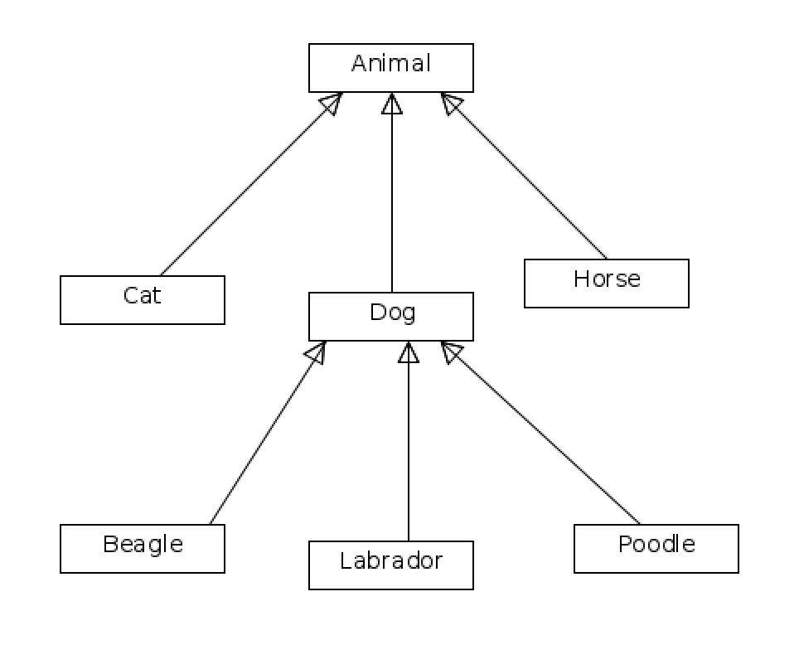
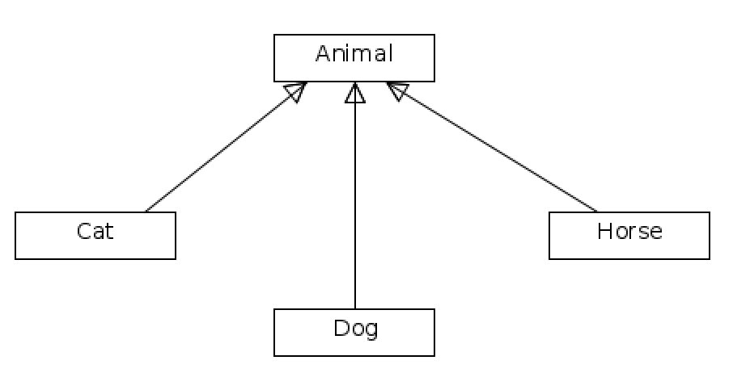
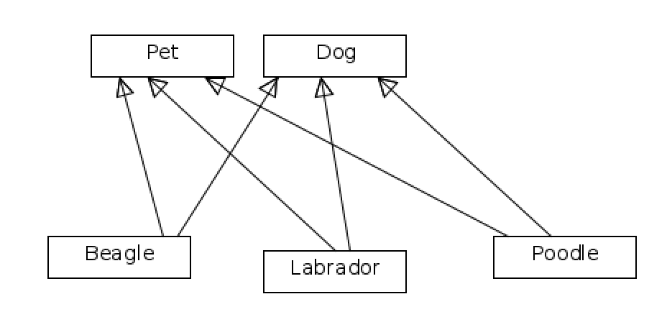
TopHat Question 2
Which of these is an invalid superclass/subclass model:
A. C.
B.
D. None of the above

Slide 26

Modeling Inheritance Example (2/3)
public class Car {
private Engine _engine;
//other variables elided
public Car() {
_engine = new Engine();
}
public void turnOnEngine() {
_engine.start();
}
public void turnOffEngine() {
_engine.shutOff();
}
public void cleanEngine() {
_engine.steamClean();
}
public void drive() {
//code elided
}
//more methods elided
}
Step 1 – define the superclass
defining Car is just like defining any other class

Slide 27

Modeling Inheritance Example (3/3)
Step 2 – define a subclass
Notice the extends keyword
extends means “is a subclass of” or “inherits from”
extends lets the compiler know that Convertible is inheriting from Car
whenever you create a class that inherits from a superclass, must include “extends <superclass name>” in class declaration
public class Convertible extends Car {
//code elided for now
}

Slide 28
Let’s examine inheritance further
Model inheritance relationship
Adding new methods
Overriding methods
Accessing Instance Variables

Slide 29
Adding new methods (1/3)
We don’t need to (re)declare any inherited methods
Our Convertible class does more than a generic Car class
Let’s add a putTopDown() method and an instance variable _top (initialized in constructor)
public class Convertible extends Car {
public Convertible(){
}
}
private ConvertibleTop _top;
_top = new ConvertibleTop();
public void putTopDown(){
//code with _top elided
}

Slide 30
Adding new methods (2/3)
Now, let’s make a new CS15Mobile class that also inherits from Car
public class CS15Mobile extends Car {
public CS15Mobile(){
}
//other methods elided
}
Can CS15Mobile putTopDown()?
Nope. That method is defined in Convertible, so only Convertible and Convertible’s subclasses can use it
public class Convertible extends Car {
private ConvertibleTop _top;
public Convertible(){
_top = new ConvertibleTop();
}
public void putTopDown(){
//code with _top elided
}
}

Slide 31
Adding new methods (3/3)
You can add specialized functionality to a subclass by defining methods
These methods can only be inherited if a class extends this subclass
Car
Doesn’t inherit Convertible’s methods
Defines Convertible’s methods
Doesn’t inherit Convertible’s methods
Convertible
CS15Mobile
Porsche
Inherits Convertible’s methods

Slide 32
Let’s examine inheritance further
Model inheritance relationship
Adding new methods
Overriding methods
Accessing Instance Variables

Slide 33
Overriding methods (1/4)
public class Car {
private Engine _engine;
//other variables elided
public Car() {
_engine = new Engine();
}
public void drive() {
this.goFortyMPH();
}
public void goFortyMPH() {
//code elided
}
//more methods elided
}
A Convertible may decide Car’s drive() method just doesn’t cut it
a Convertible drives much faster than a regular car
Can override a parent class’s method and redefine it

Slide 34
Overriding methods (2/4)
public class Convertible extends Car {
public Convertible() {
}
@Override
public void drive(){
this.goSixtyMPH();
}
public void goSixtyMPH(){
//code elided
}
}
@Override should look familiar!
saw it when we implemented an interface method
We include @Override right before we declare method we mean to override
@Override is an annotation-- signals to compiler (and to anyone reading your code) that you’re overriding a method of the superclass

Slide 35
Overriding methods (3/4)
We override methods by re-declaring and re-defining them
Be careful – in declaration, the method signature (name of method and list of parameters) and return type must match that of the superclass’s method exactly*!
or else Java will create a new, additional method instead of overriding
drive() is the method signature, indicating that name of method is drive and it takes in no parameters
public class Convertible extends Car {
public Convertible() {
}
@Override
public void drive() {
this.goSixtyMPH();
}
public void goSixtyMPH(){
//code elided
}
}
Code
from previous slide
*return type must be the same or subtype of superclass’s method’s return type, e.g., if the superclass method returns a car, the subclass method should return a car or a subclass of car

Slide 36
Overriding methods (4/4)
Fill in body of method with whatever we want a Convertible to do when it is told to drive
In this case, we’re fully overriding the method
When a Convertible is told to drive, it will execute this code instead of the code in its superclass’s drive method (Java compiler does this automagically - stay tuned)
public class Convertible extends Car {
public Convertible() {
}
@Override
public void drive(){
this.goSixtyMPH();
}
public void goSixtyMPH(){
//code elided
}
}

Slide 37
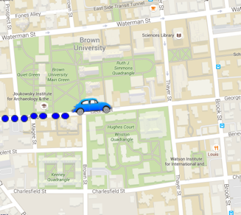

Partially overriding methods (1/6)
Let’s say we want to keep track of CS15Mobile’s route
CS15Mobile drives at the same speed as a Car, but it adds dots to a map
CIT

Slide 38
Partially overriding methods (2/6)
We need a CS15Mobile to start driving normally, and then start adding dots
To do this, we partially override the drive() method
partially accept the inheritance relationship
Car:
void drive:
Go 40mph
CS15Mobile:
void drive:
Go 40mph
Add dot to map

Slide 39
Partially overriding methods (3/6)
Just like previous example, use @Override to tell compiler we’re about to override a method
Declare the drive() method, making sure that the method signature and return type match that of superclass’s drive method
public class CS15Mobile extends Car {
public CS15Mobile() {
//code elided
}
@Override
public void drive(){
super.drive();
this.addDotToMap();
}
public void addDotToMap() {
//code elided
}
}

Slide 40
Partially overriding methods (4/6)
When a CS15Mobile drives, it first does what every Car does: goes 40mph
First thing to do in CS15Mobile’s drive method therefore is “drive as if I were just a Car, and nothing more”
Keyword super used to invoke original inherited method from parent: in this case, drive as implemented in parent Car
public class CS15Mobile extends Car {
public CS15Mobile() {
//code elided
}
@Override
public void drive(){
// super is
super.drive();
this.addDotToMap();
}
public void addDotToMap() {
//code elided
}
}
parent class
super is

Slide 41
Partially overriding methods (5/6)
After doing everything a Car does to drive, the CS15Mobile needs to add a dot to the map!
In this example, the CS15Mobile “partially overrides” the Car’s drive method: it drives the way its superclass does, then does something specialized
public class CS15Mobile extends Car {
public CS15Mobile() {
//code elided
}
@Override
public void drive(){
super.drive();
this.addDotToMap();
}
public void addDotToMap() {
//code elided
}
}

Slide 42
Partially overriding methods (6/6)
If we think our CS15Mobile should move a little more, we can call super.drive() multiple times
While you can use super to call other methods in the parent class, it’s strongly discouraged
use the this keyword instead; parent’s methods are inherited by the subclass
except when you are calling the parent’s method within the child’s method of the same name
this is partial overriding
what would happen if we said this.drive() instead of super.drive()?
public class CS15Mobile extends Car {
public CS15Mobile() {
//code elided
}
@Override
public void drive(){
super.turnOnEngine();
super.drive();
this.addDotToMap();
super.drive();
super.drive();
this.addDotToMap();
this.turnOffEngine();
}
}
bad form!
StackOverflowError

Slide 43
Method Resolution (1/3)
When we call drive() on some instance of Convertible, how does the compiler know which version of the method to call?
Starts by looking at the instance’s class, regardless of where class is in the inheritance hierarchy
if method is defined in the instance’s class, Java compiler calls it
otherwise, it checks the superclass
if method is explicitly defined in superclass, compiler calls it
otherwise, checks the superclass up one level… etc.
if a class has no superclass, then compiler throws an error

Slide 44

Method Resolution (2/3)
Essentially, the Java compiler “walks up the class inheritance tree” from subclass to superclass until it either:
finds the method, and calls it
doesn’t find the method, and generates a compile-time error. You can’t give a command for which there is no method!
Car
drive()
Convertible
drive()
topDown()
Porsche
drive()

Slide 45


Method Resolution (3/3)
When we call drive() on a Porsche, Java compiler executes the drive() method defined in Porsche
When we call topDown() on a Porsche, Java compiler executes the topDown() method defined in Convertible
Car
drive()
Convertible
drive()
topDown()
Porsche
drive()

Slide 46
Inheritance Example
Let’s use the car inheritance relationship in an actual program
Remember the race program from last lecture?
Silly Premise
the department received a ~mysterious~ donation and can now afford to give all TAs cars! (we wish)
Lucy and Angel want to race from their dorms to the CIT in their brand new cars
whoever gets there first, wins!
you get to choose which car they get to use

Slide 47
Last lecture’s final design
Transportation classes that implement the Transporter interface
A Racer class that has a useTransportation(Transporter transport) method
A Race class that contains the transportation classes and the Racers

Slide 48
A refresher on polymorphism (1/2)
public class Race {
private Racer _lucy;
//other code elided
public void startRace() {
_lucy.useTransportation(new Bike());
}
}
With last lecture’s example, we used polymorphism to pass in different types of transportation to the useTransportation method of the Racer class
public class Racer {
//previous code elided
public void useTransportation(Transporter transport) {
transport.move();
}
}

Slide 49
A refresher on polymorphism (2/2)
A list of transporters can include cars, bikes, planes... but the only method we can call on each transporter is the move method defined by the Transporter interface
We can only call methods that Transporter declares
we sacrifice specificity for generality
Why is this useful?
allows us to interact with more objects generally
i.e., a list of Transporters
can’t have a list of Cars and Bikes
Transporter bike = new Bike();
Transporter car = new Car();

Slide 50
Inheritance Example
What classes will we need for this lecture’s program?
old: App, Racer
new: Car, Convertible, CS15Mobile, Van
Rather than using any Transporter, Lucy and Angel are limited to only using Cars
for now, transportation options have moved from Bike and Car to Convertible, CS15Mobile, and Van
How do we modify Racer’s useTransportation() method to reflect that?
can we use polymorphism here?

Slide 51
Inheritance and Polymorphism (1/3)
What is the “lowest common denominator” between Convertible, CS15Mobile, and Van?
Car
Car is the LCD!
Van
CS15Mobile
Convertible

Slide 52
Inheritance and Polymorphism (2/3)
Can we refer to CS15Mobile as its more generic parent, Car?
Declaring CS15Mobile as a Car follows the same process as declaring a Bike as a Transporter object
Transporter and Car are the declared types
Bike and CS15Mobile are the actual types
Transporter bike = new Bike();
Car car = new CS15Mobile();

Slide 53
Inheritance and Polymorphism (3/3)
What would happen if we made Car the type of the parameter passed into useTransportation?
we can only pass in Car and subclasses of Car
public class Racer {
//previous code elided
public void useTransportation(Car myCar) {
//code elided
}
}

Slide 54


Is this legal?
Car convertible = new Convertible();
_lucy.useTransportation(convertible);
Car cs15Mobile = new CS15Mobile();
_lucy.useTransportation(cs15Mobile);
Car bike = new Bike();
_lucy.useTransportation(bike);
Bike is not a subclass of Car, so you cannot treat an instance of Bike as a Car.

Slide 55
Inheritance and Polymorphism (1/2)
Let’s define useTransportation()
What method should we call on myCar?
every Car knows how to drive, which means we can guarantee that every subclass of Car also knows how to drive
public class Racer {
//previous code elided
public void useTransportation(Car myCar) {
myCar.drive();
}
}

Slide 56
Inheritance and Polymorphism (2/2)
That’s all we needed to do!
Our inheritance structure looks really similar to our interfaces structure
therefore, we only need to change 2 lines in Racer in order to use any of our new Cars!
but remember- what’s happening behind the curtain is very different: method resolution “climbs up the hierarchy” for inheritance
Polymorphism is an incredibly powerful tool
allows for generic programming
treats multiple classes as their generic type while still allowing specific method implementations for specific subclasses to be executed
Polymorphism + Inheritance is good coding practice

Slide 57
TopHat Question 3
In the following code, the Salesman subclass extends the Employee superclass. Employee contains and defines a work() method, and Salesman overrides that method.
Employee jim = new Salesman();
jim.work();
Whose work() method is being called?
Employee
jim
dwight
Salesman

Slide 58
Let’s examine inheritance further
Model inheritance relationship
Adding new methods
Overriding methods
Accessing Instance Variables

Slide 59
Accessing Superclass Instance Variables (1/3)
Can Convertible access _engine?
private instance variables or private methods of a superclass are not directly inherited by its subclasses
superclass protects them from manipulation by its own subclasses
Convertible cannot directly access any of Car’s private instance variables
In fact, Convertible is completely unaware that _engine exists! Encapsulation for safety!
programmers typically don’t have access to superclass’ code – know what methods are available but not how they’re implemented
public class Car {
private Engine _engine;
//other variables elided
public Car(){
_engine = new Engine();
}
public void turnOnEngine() {
_engine.start();
}
public void turnOffEngine() {
_engine.shutOff();
}
public void drive() {
//code elided
}
//more methods elided
}

Slide 60


Accessing Superclass Instance Variables (2/3)
But that’s not the whole story…
Every instance of a subclass is also an instance of its superclass – every instance of Convertible is also a Car
But you can’t access _engine directly by Convertible’s specialized methods
Instead parent can make a method available for us by its subclasses (cleanEngine())
public class Car {
private Engine _engine;
//other instance variables elided
//constructor elided
public void cleanEngine() {
_engine.steamClean();
}
}
public class Convertible extends Car {
//constructor elided
public void cleanCar() {
this.cleanEngine();
//additional code
}
}
public class Convertible extends Car {
//constructor elided
public void cleanCar() {
_engine.steamClean();
//additional code
}
}

Slide 61
Accessing Superclass Instance Variables (3/3)
What if superclass’s designer wants to allow subclasses access (in a safe way) to some of its instance variables directly for their own needs?
For example, different subclasses might each want to do something different to an engine, but we don’t want to factor out and put each specialized method into the superclass Car (or more typically, we can’t even access Car to modify it)
Car can provide controlled indirect access by defining public accessor and mutator methods for private instance variables

Slide 62
Defining Accessors and Mutators in Superclass
Assume Car also has _myRadio; Radio class defines setFavorite() method
Car can provide access to _myRadio via getRadio() and setRadio(…) methods
Important to consider this design decision in your own programs – which properties will need to be directly accessible to other classes?
don’t always need both set and get
they should be provided very sparingly
setter should error-check received parameter(s) so it retains some control, e.g., don’t allow negative values
public class Car {
//other instance variables
public Car() {
//other initialization
}
//other methods
public Radio getRadio(){
return _myRadio;
}
public void setRadio(Radio radio){
_myRadio = radio;
}
}
private Radio _myRadio;
_myRadio = new Radio();
accessor
mutator

Slide 63
Review of Inheritance and Indirect (“pseudo”) Inheritance of Instance Variables
Methods are inherited, potentially (partially) overridden
Additional methods and instance variables are defined to specialize the subclass
Instance variables are also inherited, but only “pseudo-inherited”, i.e., are part of a subclass’ set of properties…but they can’t be directly accessed by the subclass
Instead, accessor/mutator methods are the proper mechanism with which a subclass can change those properties
This provides the parent with protection against children’s potential misbehavior
Subclass
Method
Mutator
Method
Instance Vars
Method
Accessor
Method
Method
Method
defined by subclass
inherited from superclass
Method
Method

Slide 64
Calling Accessors/Mutators From Subclass
Convertible can get a reference to _radio by calling this.getRadio()
subclasses automatically inherit these public accessor and mutator methods
Note that using “double dot” we’ve chained two methods together
first, getRadio is called, and returns the radio
next, setFavorite is called on that radio
public class Convertible extends Car {
public Convertible() {
}
public void setRadioPresets(){
this.getRadio().setFavorite(1, 95.5);
this.getRadio().setFavorite(2, 92.3);
}
}

Slide 65
Let’s step through some code
Somewhere in our code, a Convertible is instantiated
The next line of code calls setRadioPresets()
Let’s step into setRadioPresets()
//somewhere in the program
Convertible convertible = new Convertible();
convertible.setRadioPresets();

Slide 66
Code Step Through
Someone calls setRadioPresets() on a Convertible– first line is this.getRadio()
getRadio() returns _myRadio
What is the value of _myRadio at this point in the code?
was it initialized when Convertible was instantiated?
Java will, in fact, call superclass constructor by default, but we don’t want to rely on that
public class Convertible extends Car {
public Convertible() { //code elided
}
public void setRadioPresets() {
.setFavorite(1, 95.5);
this.getRadio().setFavorite(2, 92.3);
}
}
this.getRadio()
public class Car {
private Radio _myRadio;
//constructor initializing _myRadio and ```//other code elided
public Radio getRadio() {
}
}
return _myRadio;

Slide 67
Making Sure Superclass’s Instance Variables are Initialized
Convertible may declare its own instance variables, which are initialized in its constructor, but what about instance variables pseudo-inherited from Car?
Car’s instance variables are initialized in its constructor
but we don’t instantiate a Car when we instantiate a Convertible!
When we instantiate Convertible, how can we make sure Car’s instance variables are initialized too via an explicit call?
want to call Car’s constructor without making an instance of a Car via new

Slide 68
super(): Invoking Superclass’s Constructor (1/4)
Car’s instance variables (like _radio) are initialized in Car’s constructor
To make sure that _radio is initialized whenever we instantiate a Convertible, we need to call superclass Car’s constructor
The syntax for doing this is “super()”
Here super() is the parent’s constructor; before, in partial overriding when we used super.drive, “super” referred to the parent itself (verb vs. noun distinction)
public class Convertible extends Car {
private ConvertibleTop _top;
public Convertible() {
super();
_top = new ConvertibleTop();
this.setRadioPresets();
}
public void setRadioPresets(){
this.getRadio().setFavorite(1, 95.5);
this.getRadio().setFavorite(2, 92.3);
}
}

Slide 69
super(): Invoking Superclass’s Constructor (2/4)
We call super() from the subclass’s constructor to make sure the superclass’s instance variables are initialized properly
even though we aren’t instantiating an instance of the superclass, we need to construct the superclass to initialize its instance variables
Can only make this call once, and it must be the very first line in the subclass’s constructor
public class Convertible extends Car {
private ConvertibleTop _top;
public Convertible() {
super();
_top = new ConvertibleTop();
this.setRadioPresets();
}
public void setRadioPresets(){
this.getRadio().setFavorite(1, 95.5);
this.getRadio().setFavorite(2, 92.3);
}
}
Code
from previous slide
Note: Our call to super() creates one copy of the instance variables, located deep inside the subclass, but accessible to sub class only if class provides setters/getters (see diagram in slide 57)

Slide 70
super(): Invoking Superclass’s Constructor (3/4)
What if the superclass’s constructor takes in a parameter?
We’ve modified Car’s constructor to take in a Racer as a parameter
How do we invoke this constructor correctly from the subclass?
public class Car {
private Racer _driver;
public Car( ) {
_driver = driver;
}
public Racer getRacer() {
return _driver;
}
}
Racer driver

Slide 71
super(): Invoking Superclass’s Constructor (4/4)
In this case, need the Convertible’s constructor to also take in a Racer
This way, Convertible can pass on the instance of Racer it receives to Car’s constructor
The Racer is passed as an argument to super() – now Racer’s constructor will initialize Car’s _driver to the instance of Racer that was passed to the Convertible
public class Convertible extends Car {
private ConvertibleTop _top;
public Convertible( ) {
super(driver);
_top = new ConvertibleTop();
}
public void dragRace(){
this.getRacer().stepOnIt();
}
}
Racer driver

Slide 72
What if we don’t call super()?
If you don’t explicitly call super() first thing in your constructor, Java compiler automatically calls it for you, passing in no arguments
But if superclass’s constructor requires an argument, you’ll get an error!
In this case, we get a compiler error saying that there is no constructor “public Car()”, since it was declared with a parameter
public class Convertible extends Car {
private ConvertibleTop _top;
public Convertible(Racer driver) {
//oops, forgot to call super(…)
_top = new ConvertibleTop();
}
public void dragRace(){
this.getRacer().stepOnIt();
}
}

Slide 73
Constructor Parameters
Does CS15Mobile need to have the same number of parameters as Car?
Nope!
as long as Car’s parameters are among the passed parameters, CS15Mobile’s constructor can take in anything else it wants to do its job
Let’s modify all the subclasses of Car to take in a number of Passengers

Slide 74
Constructor Parameters
public class Convertible extends Car {
private Passenger _p1;
public Convertible(Racer driver, Passenger p1) {
super(driver);
_p1 = p1;
}
//code with passengers elided
}
Notice how we only need to pass driver to super()
We can add additional parameters in the constructor that only the subclasses will use
public class CS15Mobile extends Car {
private Passenger _p1, _p2, _p3, _p4;
public CS15Mobile(Racer driver, Passenger p1, Passenger p2, Passenger p3, Passenger p4) {
super(driver);
_p1 = p1;
_p2 = p2;
_p3 = p3;
_p4 = p4;
}
//code with passengers elided
}

Slide 75

abstract Methods and Classes (1/6)
What if we wanted to seat all of the passengers in the car?
CS15Mobile, Convertible, and Van all have different numbers of seats
they will all have different implementations of the same method

Slide 76
abstract Methods and Classes (2/6)
We declare a method abstract in a superclass when the subclasses can’t really re-use any implementation the superclass might provide – no code-reuse
In this case, we know that all Cars should loadPassengers, but each subclass will loadPassengers very differently
abstract method is declared in superclass, but not defined – it is up to subclasses farther down hierarchy to provide their own implementations
Thus superclass specifies a contractual obligation to its subclasses – just like an interface does to its implementors

Slide 77
abstract Methods and Classes (3/6)
Here, we’ve modified Car to make it an abstract class: a class with at least one abstract method
We declare both Car and its loadPassengers method abstract: if one of a class’s methods is abstract, the class itself must also be declared abstract
An abstract method is only declared by the superclass, not implemented – thus use semicolon after declaration instead of curly braces
public class Car {
private Racer _driver;
public Car(Racer driver) {
_driver = driver;
}
public abstract void loadPassengers();
}
abstract

Slide 78
abstract Methods and Classes (4/6)
How do you load Passengers?
every Passenger must be told to sit in a specific Seat in a physical Car
SeatGenerator has methods that returns a Seat in a specific logical position
public class SeatGenerator {
public SeatGenerator () {//code elided }
public Seat getShotgun() {//code elided }
public Seat getBackLeft() {//code elided }
public Seat getBackCenter() {//code elided }
public Seat getBackRight() {//code elided }
public Seat getMiddleLeft() {//code elided }
public Seat getMiddleRight() {//code elided }
}
public class Passenger {
public Passenger() { //code elided }
public void sit(Seat st) { //code elided }
}

Slide 79
abstract Methods and Classes (5/6)
public class Convertible extends Car{
@Override
public void loadPassengers(){
SeatGenerator seatGen = new SeatGenerator();
_passenger1.sit(
seatGen.getShotgun());
}
}
public class CS15Mobile extends Car{
@Override
public void loadPassengers(){
SeatGenerator seatGen = new SeatGenerator();
_passenger1.sit(seatGen.getShotgun());
_passenger2.sit(seatGen.getBackLeft());
_passenger3.sit(seatGen.getBackCenter());
}
}
public class Van extends Car{
@Override
public void loadPassengers(){
SeatGenerator seatGen = new SeatGenerator();
_passenger1.sit(seatGen.getMiddleLeft());
_passenger2.sit(seatGen.getMiddleRight());
_passenger3.sit(seatGen.getBackLeft());
//more code elided
}
}
All concrete subclasses of Car override by providing a concrete implementation for Car’s abstract loadPassengers() method
As usual, method signature must match the one that Car declared

Slide 80
abstract Methods and Classes (6/6)
abstract classes cannot be instantiated!
this makes sense – shouldn’t be able to just instantiate a generic Car, since it has no code to loadPassengers()
instead, provide implementation of loadPassengers() in concrete subclass, and instantiate subclass
Subclass at any level in inheritance hierarchy can make an abstract method concrete by providing implementation
it’s common to have multiple consecutive levels of abstract classes before reaching a concrete class
Even though an abstract class can’t be instantiated, its constructor must still be invoked via super() by a subclass
because only the superclass knows about (and therefore only it can initialize) its own instance variables

Slide 81
So.. What’s the difference?
You might be wondering: what’s the difference between abstract classes and interfaces?
abstract classes:
can define instance variables
can define a mix of concrete and abstract methods
you can only inherit from one class
Interfaces:
cannot define any instance variables/concrete methods
think of an interface as a class with only undefined methods (no instance variables)
but you can implement multiple interfaces
Note: Java, like most programming languages, is evolving. In Java 8, interfaces and abstract classes are even closer in that you can have concrete methods in interfaces. We will not make use of this in CS15.

Slide 82
Quick Comparison: Inheritance and Interfaces
Inheritance
Interface
Each subclass can only inherit from one superclass
Useful for when classes have more similarities than differences
is-a relationship: classes that extend another class
i.e. A Convertible is-a Car
Can define more methods to use
i.e. Convertible putting its top down
You can implement as many interfaces as you want
Useful for when classes have more differences than similarities
acts-as relationship: classes implementing an interface define its methods
Can only use methods defined in the interface

Slide 83
Summary
Inheritance models very similar classes
factor out all similar capabilities into a generic superclass
superclasses can
declare and define methods
declare abstract methods
subclasses can
inherit methods from a superclass
define their own specialized methods
completely/partially override an inherited method
Polymorphism allows programmers to reference instances of a subclass as their superclass
Inheritance, Interfaces, and Polymorphism take generic programming to the max – more in later lecture
will use polymorphism with inheritance and interfaces in Fruit Ninja

Slide 84
Announcements
LiteBrite early deadline is tonight at 11:59pm
Ontime is Thursday at 11:59pm, Late is Saturday at 10pm
If you have not received a HW1 grade, email the HTAs ASAP!
Lab 2 is out! Make sure to go to the Sunlab for this week’s section!

